Slide 1
CUSTOMERS REVIEW ANALYSIS
SOLOMON FAITH O.
BRITISH AIRWAYS

Slide 2
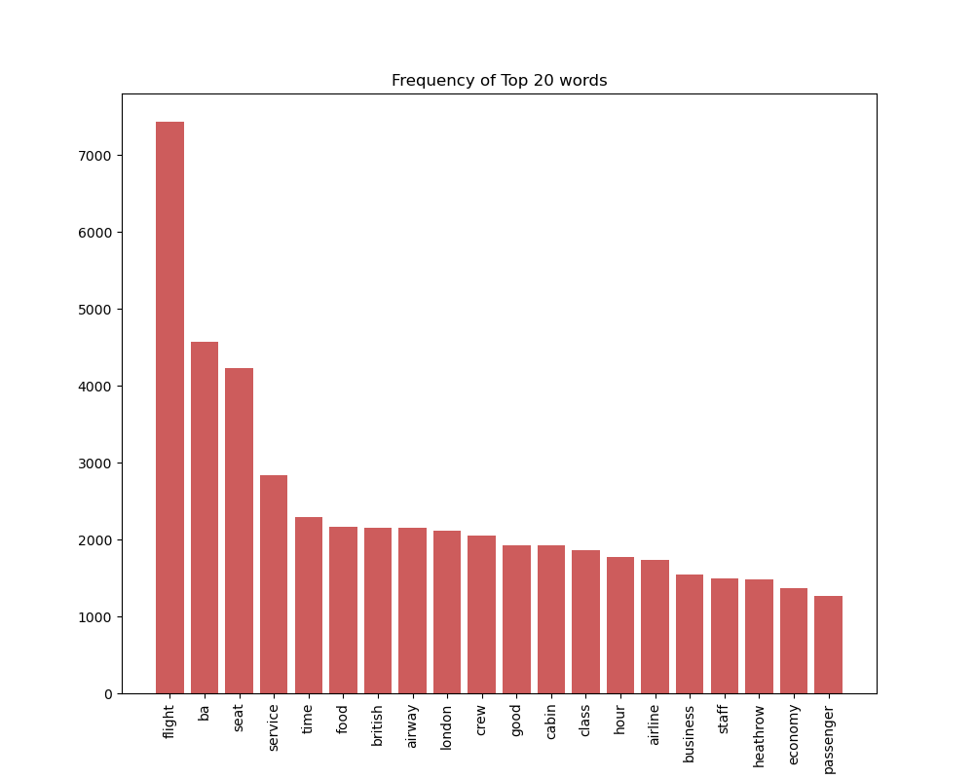
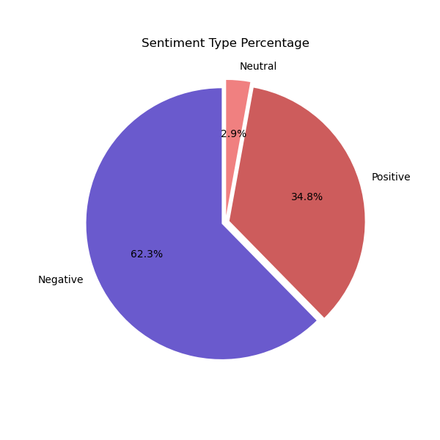
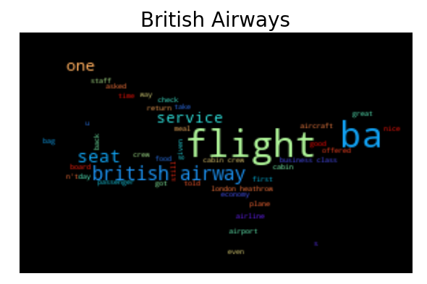
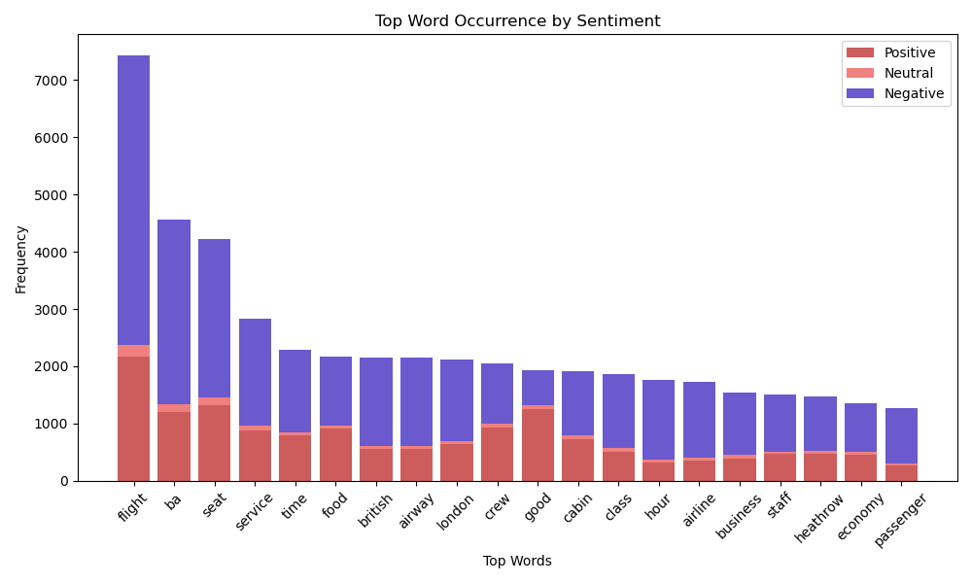
According to this analysis, we have more negative reviews than positive, neutral reviews are very low, taking about 2.9% of the total reviews.
The most used keyword word by the users is “flight”.

